Slide 1
FYP5: Object Detection, Tracking and Suspicious Activity Recognition for Maritime Surveillance using Thermal Vision

Slide 2
Weekly Tasks
SMD Dataset Creation
Training on CenterNet
Research work

Slide 3
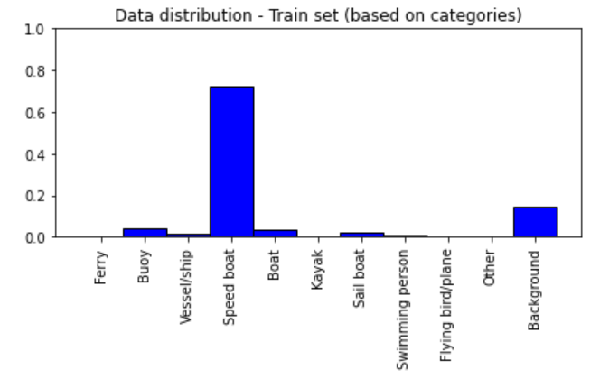
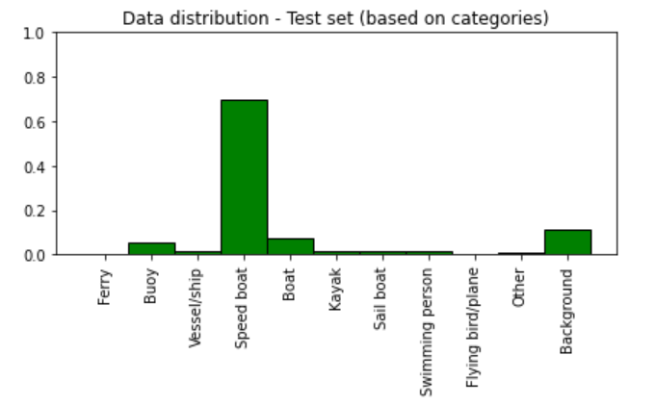
New Singapore Maritime Dataset
Changes we made
Combined Onshore, Onboard and NIR images together
Split the complete dataset by ensuring all the classes in the test set are present in the train set
Created only two sets (No validation set)
Analysis

Slide 4
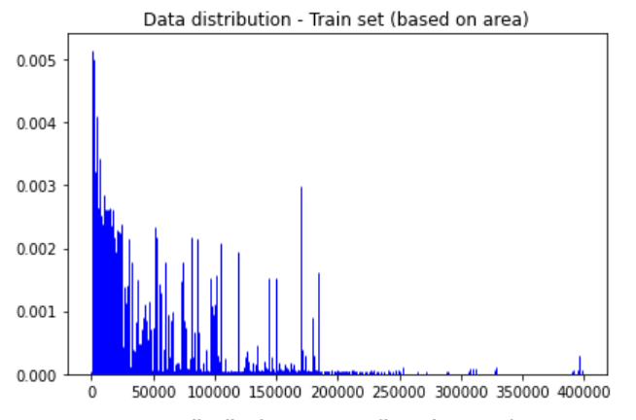
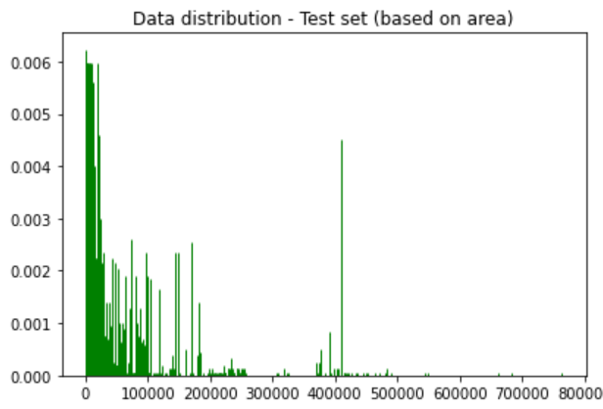

Slide 5
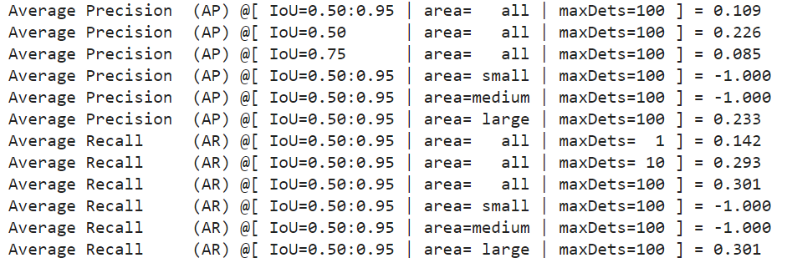
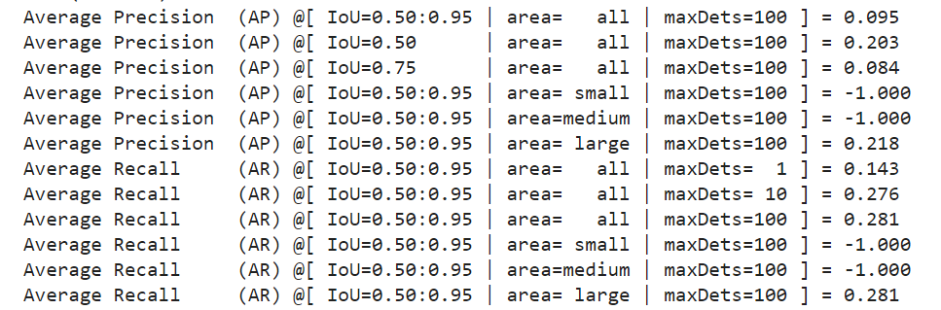
Training on CenterNet
30 Epochs
20 Epochs

Slide 6

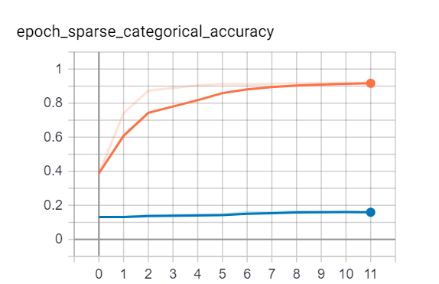
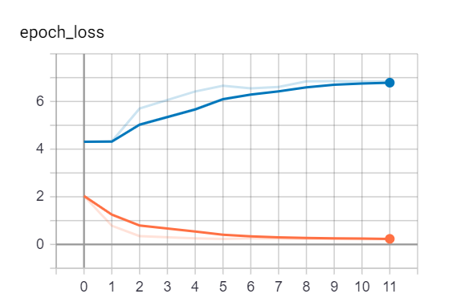
STA Network

